Slide 1

TEAM-12
Project Review - 4
TRAFFIC LIGHT USING ARDUINO UNO
DEPARTMENT OF MASTERS IN COMPUTER APPLICATIONS
Submitted by
Adhithyan.S - (23205003)
Azmal Babu.B - (23205008)
Mohamed Irfan.J - (23205030)
Prakalathan.G - (23205036)
Guided by
Varsha J.J M.C.A.,
Assistant Professor

Slide 2

OUTLINE
INTRODUCTION
OBJECTIVES
ABSTRACT
KEY COMPONENTS
TOOLS USED
METHODOLOGY
EXISTING SYSTEM
PROPOSED METHOD
COMPARISON TABLE
CONNECTION DIAGRAM
OUTPUT

Slide 3
INTRODUCTION
The traffic light system proves to be very vital in controlling vehicle flow at the interchanges in towns, prevents accidents, and reduces congestion as well, giving a clear indication whether to stop, get ready, or go. We will hereby simplify the making of a simple traffic light using an Arduino Uno, LEDs, and other basic components simulating the natural and real traffic lights. This provides for a teaching opportunity in the control of electronic circuits as well as programming basics with Arduino.

Slide 4
OBJECTIVES
The primary objective of this project is to create a functioning traffic light system that simulates the basic operation of a real-world traffic light. The system will sequentially control three LEDs to mimic the red, yellow, and green lights, implementing the standard traffic light sequence.
With the integration of artificial intelligence, sensors, and machine learning algorithms, traffic management will be revolutionised.We can expect to see a shift towards a more seamless and connected traffic system with fewer accidents and less time wasted sitting in traffic.
Primary Goal: Implement a functional IoT system for a specific use case, such as smart home automation, weather monitoring, or health tracking.
Secondary Goals:
Demonstrate how sensors interact with Arduino Uno to collect data.
Utilize a communication module (e.g., ESP8266) to send data to the internet.
Build a basic dashboard or mobile app for visualization and control (optional).

Slide 5
ABSTRACT
This project aims to design and implement a traffic light control system using an Arduino Uno microcontroller. Traffic lights are essential components of modern traffic management systems, ensuring safe and efficient movement of vehicles and pedestrians. In this project, LEDs are used to simulate traffic signals: red, yellow, and green. The Arduino Uno serves as the central processing unit, programmed to control the sequence and timing of the lights. The system operates on a predefined logic to mimic real-world traffic lights, switching between different states with appropriate delays. This project demonstrates the practical application of microcontrollers in everyday automation and serves as an educational tool for understanding basic electronics and programming concepts. The design is scalable and can be expanded with additional features such as pedestrian signals, timers, or sensors for vehicle detection.

Slide 6
KEY COMPONENTS
Sensors and Actuators: Collect data from the environment (e.g., temperature, humidity).
Connectivity: Transmit data using Wi-Fi, Bluetooth, or cellular networks.
Microcontrollers or Microprocessors: Process and manage data (e.g., Arduino, Raspberry Pi).
Cloud Platforms: Store and analyze data (e.g., AWS IoT, Firebase).
User Interfaces: Mobile apps or dashboards for monitoring and control.

Slide 7
TOOLS USED
Arduino Uno: The microcontroller board used to control the LEDs
LEDs (Red, Yellow, Green): Representing the traffic lights.
Resistors (220 ohms): To limit the current through the LEDs.
Breadboard: For prototyping the circuit.
Jumper Wires: For connecting components.
USB Cable: To upload code and power the Arduino.
Arduino IDE: Software to write and upload code to the Arduino.

Slide 8

SOFTWARE REQUREMENT
ARDUINO IDE
SOFTWARE
Arduino is a open source electronics platform based on hardware and software.

Slide 9
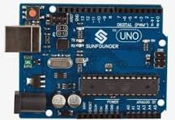
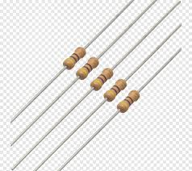
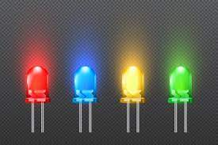
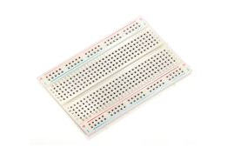
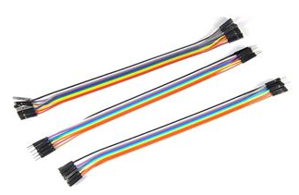
COMPONENTS REQUIRED
Arduino Uno
LED Vectors
Resistors
Breadboard
Jumper wires

Slide 10
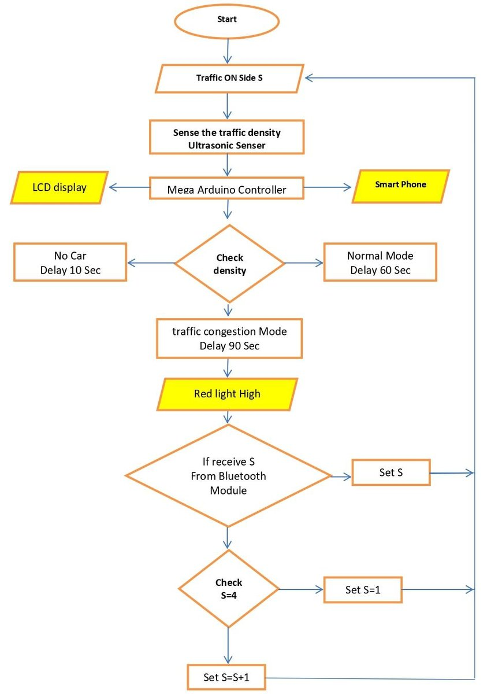
BLOCK DIAGRAM

Slide 11
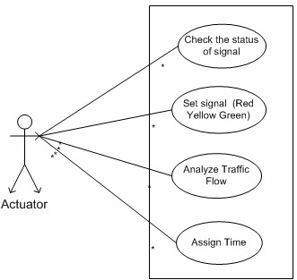
USECASE DIAGRAM

Slide 12
METHODOLOGY
Designing the Circuit: A breadboard is used to connect LEDs and resistors to the Arduino Uno. Each LED is connected to a specific pin on the Arduino.
Programming the Arduino: Using the Arduino IDE, code is written to control the timing sequence of the LEDs (Red, Yellow, and Green) to mimic the operation of a real traffic light.
Testing: After uploading the code, the circuit is tested to ensure the LEDs light up in the correct order and with the proper timing.
Adjustments: The timing of each light can be adjusted in the code to simulate different traffic situations, like peak hours.

Slide 13
EXISTING SYSTEM
The existing system of traffic control typically involves hardware-based controllers and software systems. Most traffic lights use dedicated microcontrollers and are often part of an interconnected traffic management system, allowing centralized control for entire cities. These systems are robust but can be costly and require specialized knowledge for setup and maintenance.

Slide 14
PROPOSED METHOD
This project proposes a simplified version of a traffic light system using the Arduino Uno. It focuses on creating a standalone model that mimics real traffic signals.
The Arduino Uno controls the sequence and duration of lights, offering a low-cost, easy-to-understand alternative to more complex systems.
The project serves as an educational tool for beginners in electronics and programming.

Slide 15
COMPARISON TABLE
Feature | Existing system | Proposed System
Hardware Complexity | High | Low
Cost | High | Low
Ease of Implementation | Requires specialized skills | Beginner-friendly with basic knowledge
Scalability | High | Limited to small-scale demonstrations
Customizability | Limited by hardware | Easily customizable through code

Slide 16
CONNECTION
Red LED: Connected to pin 9 of the Arduino through a 220-ohm resistor.
Yellow LED: Connected to pin 10 of the Arduino through a 220-ohm resistor.
Green LED: Connected to pin 11 of the Arduino through a 220-ohm resistor.
Ground: The other side of each resistor connects to the common ground (GND) on the Arduino.

Slide 17
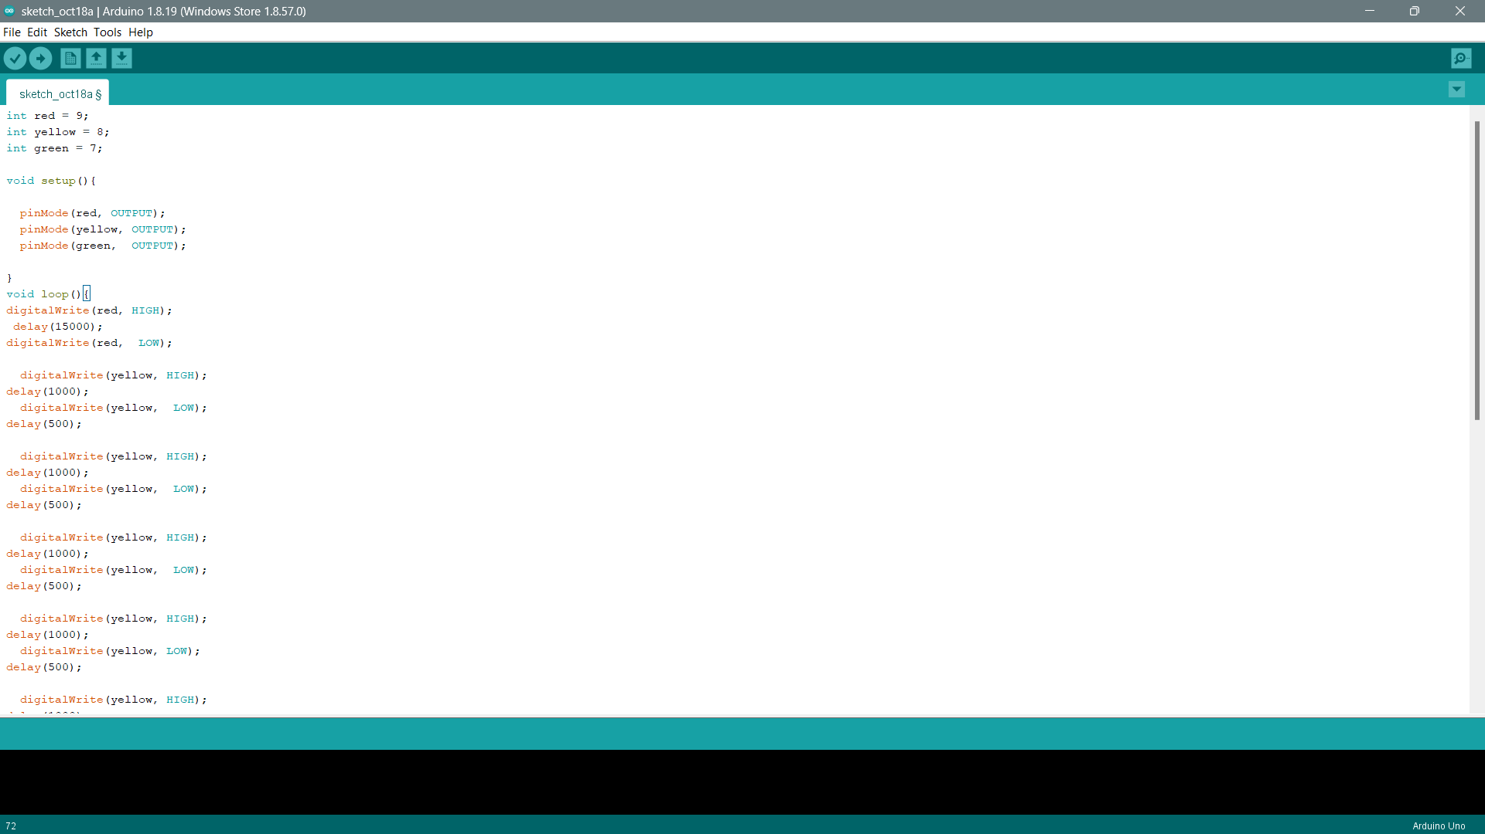
CODE

Slide 18
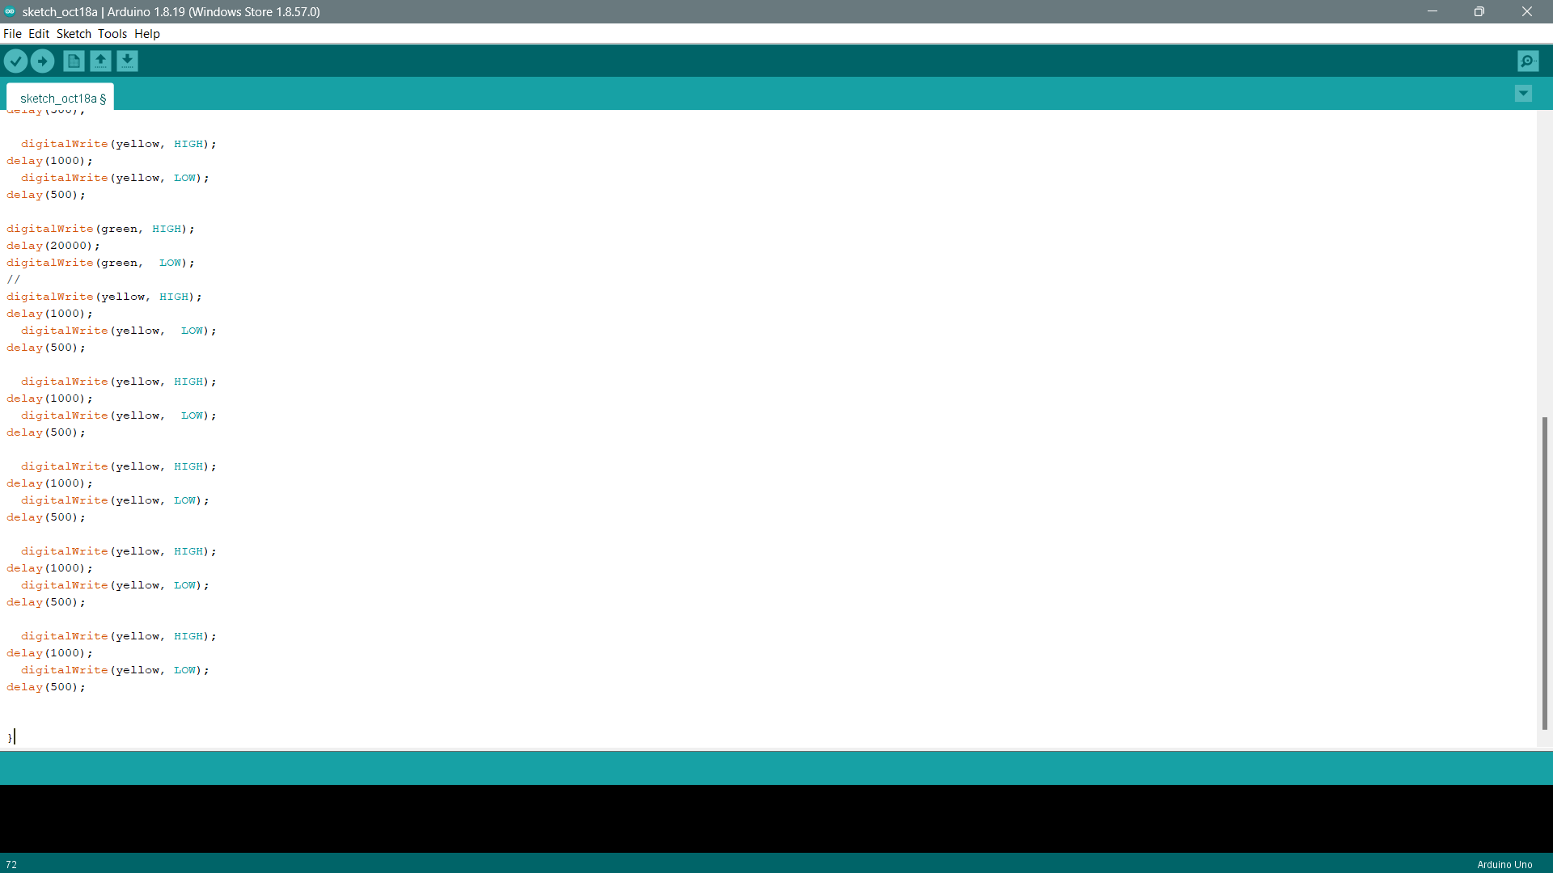

Slide 19
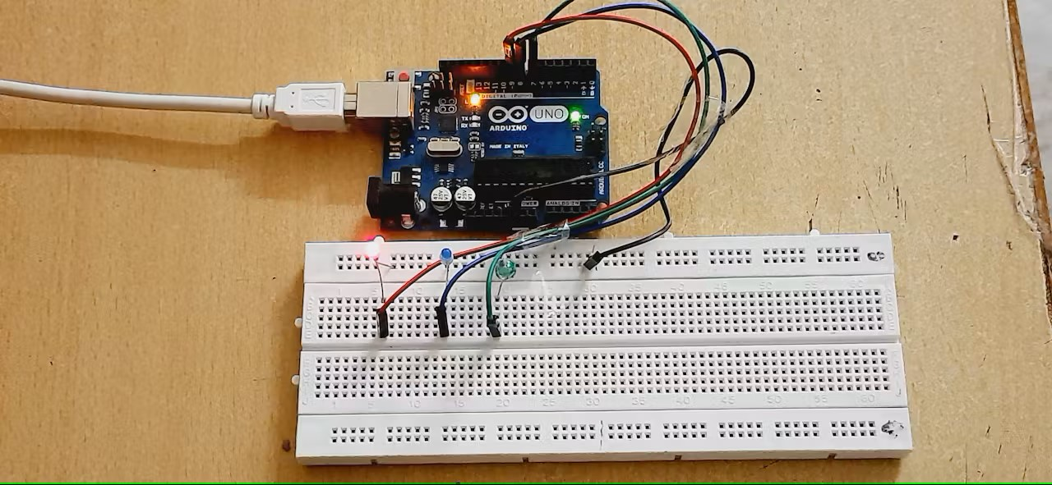
OUTPUT

Slide 20
ANY QUERIES ?

Slide 21
THANK YOU☺

